Slide 1


Day 1 Keynote
Brad Green
Igor Minar

Slide 2
Hello!

Slide 3
Principles

Slide 4
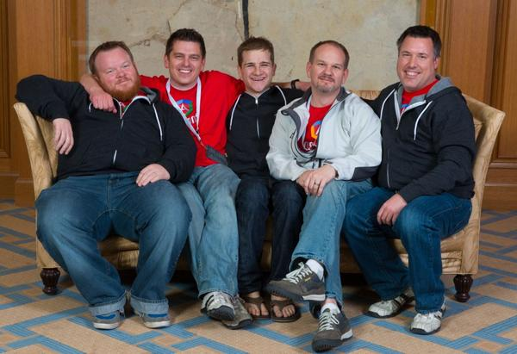
Our Hosts

Slide 5
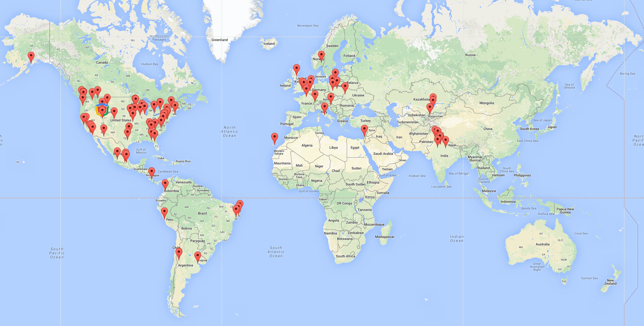
Hello, ng-conf extended!
29+ countries
150+ sites
8000+ people

Slide 6
Why are we here?

Slide 7
Soul searching baloney

Slide 8
Built for us

Slide 9
Trust & responsibility

Slide 10
Evolving Angular

Slide 11
How we work

Slide 12
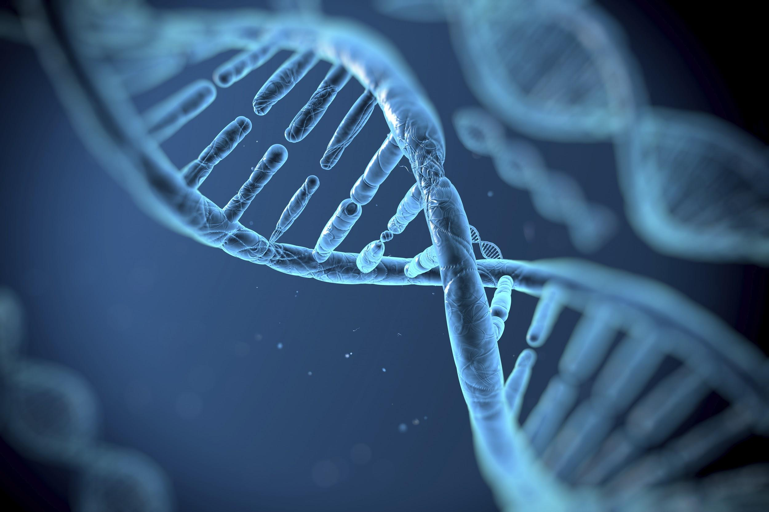

Project models
Closed source
Open source export
Open source w/ community involvement

Slide 13
ng-team

Slide 14
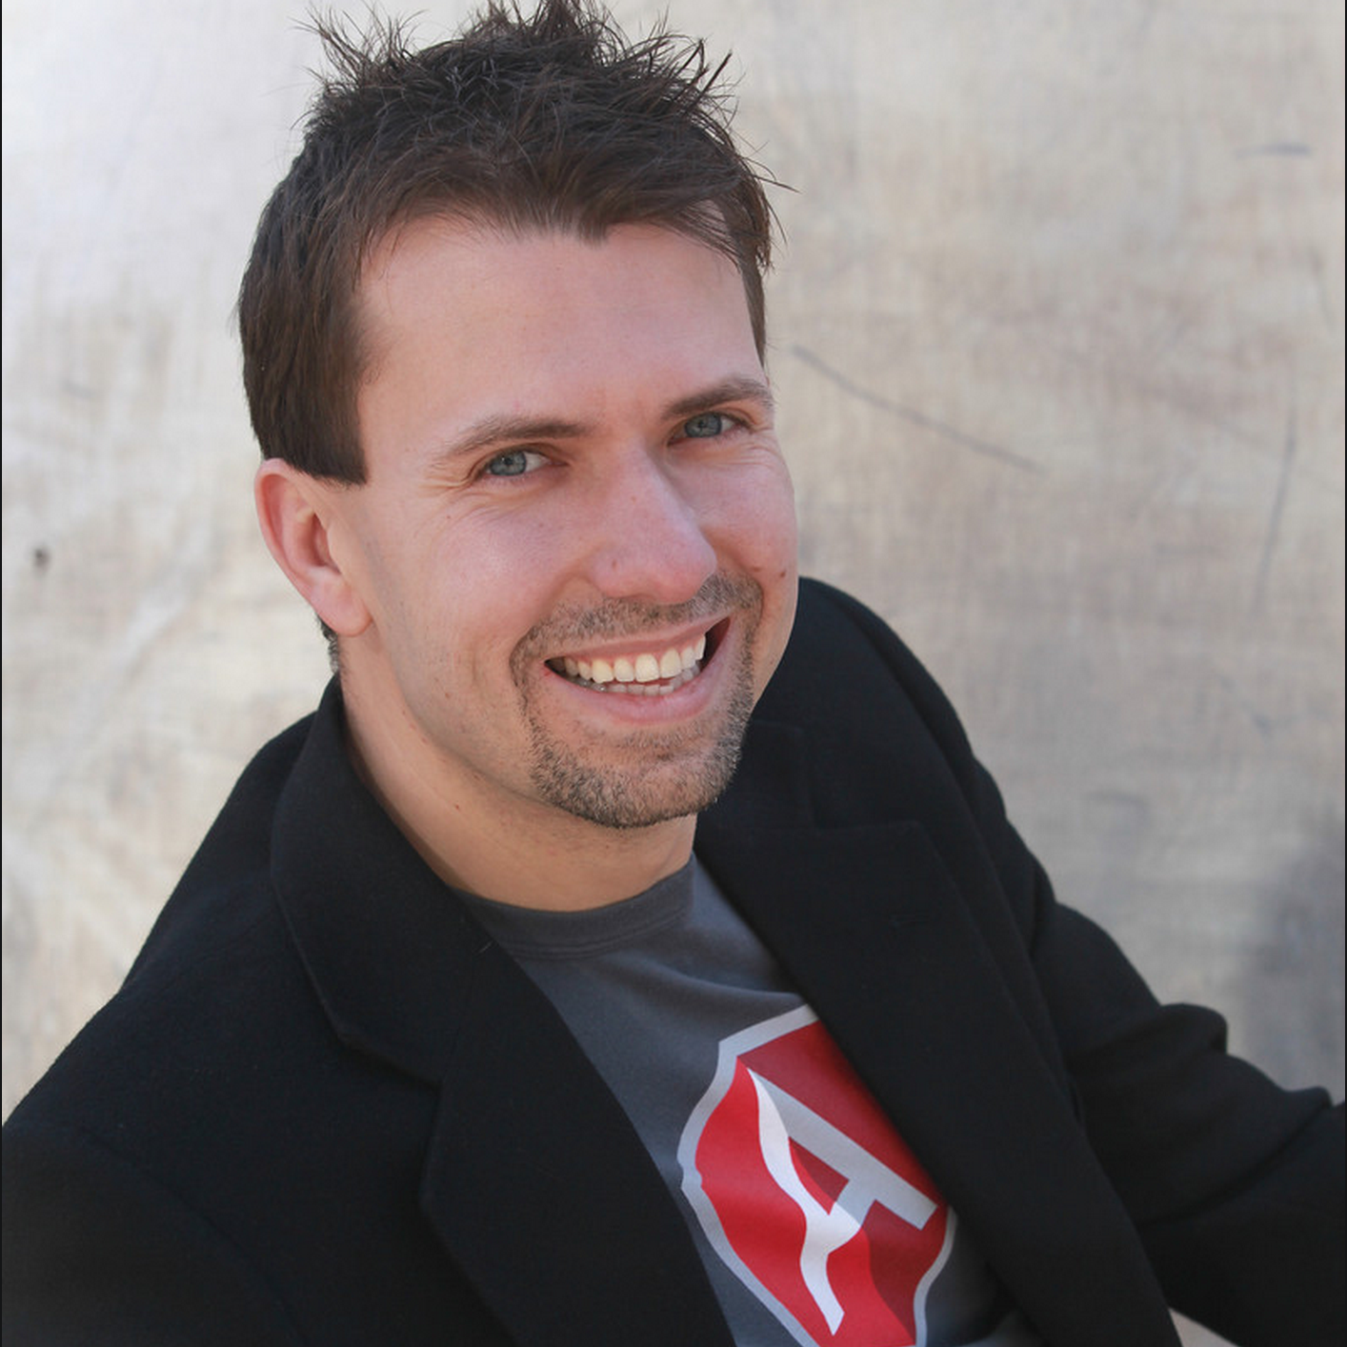
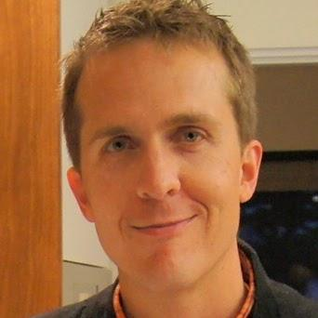
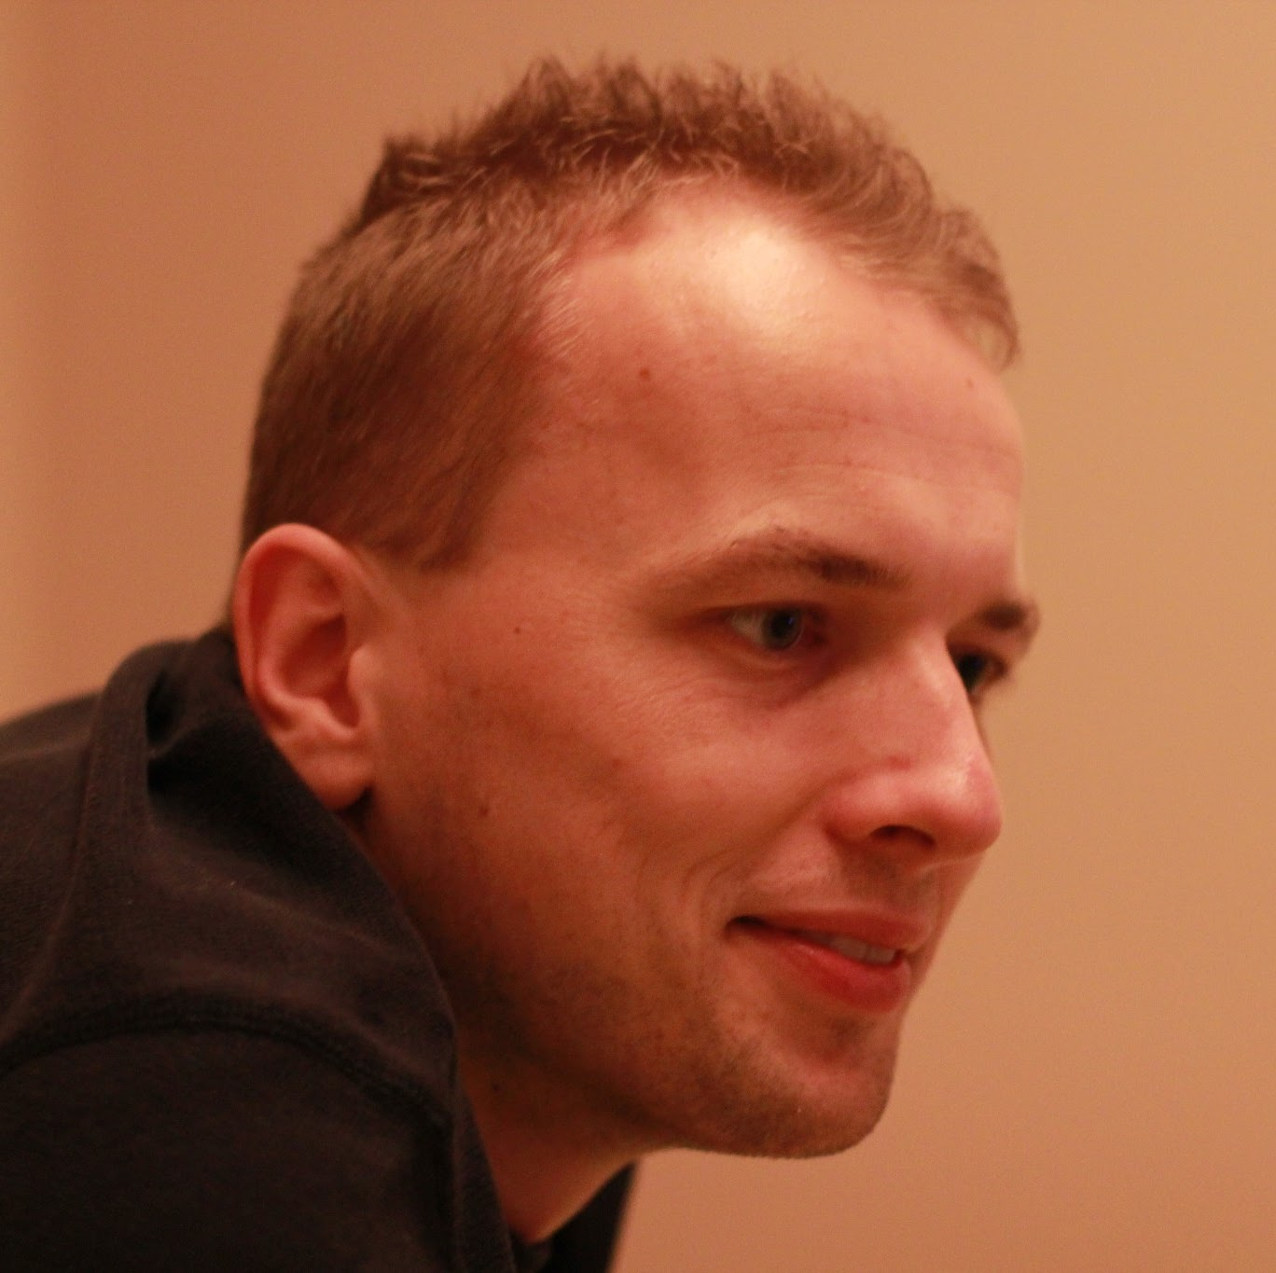



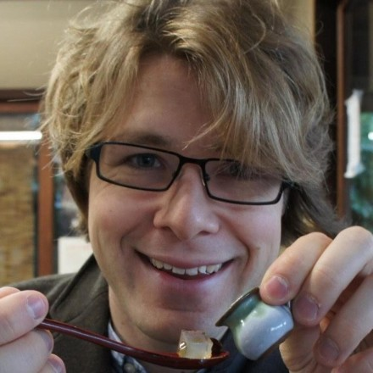

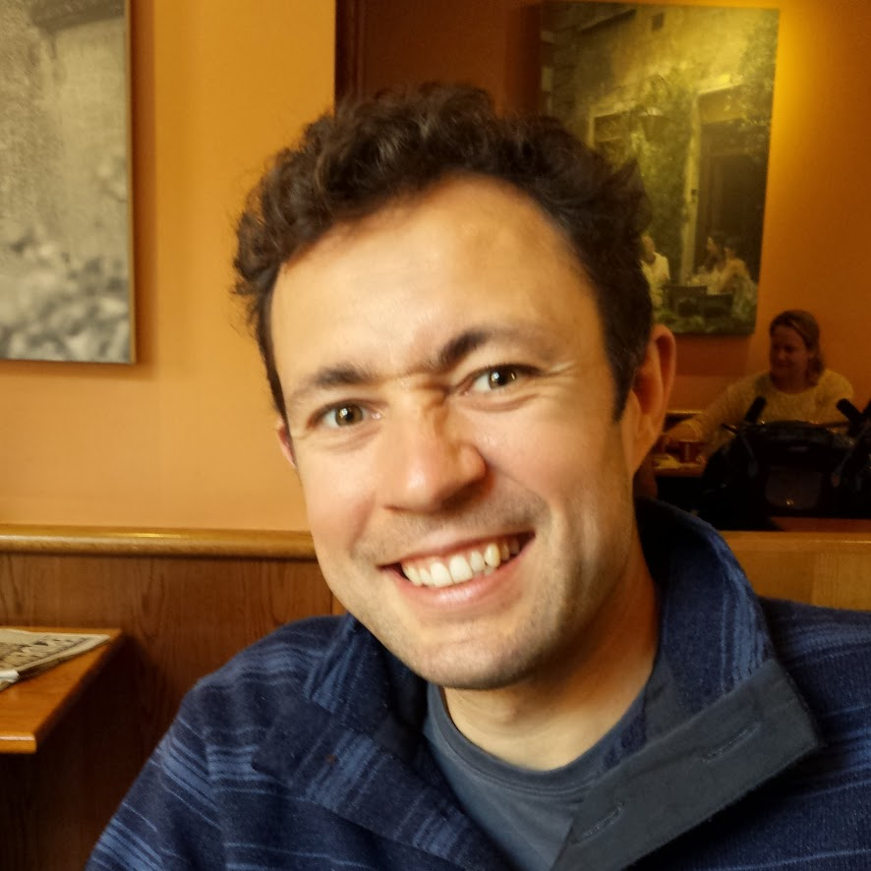

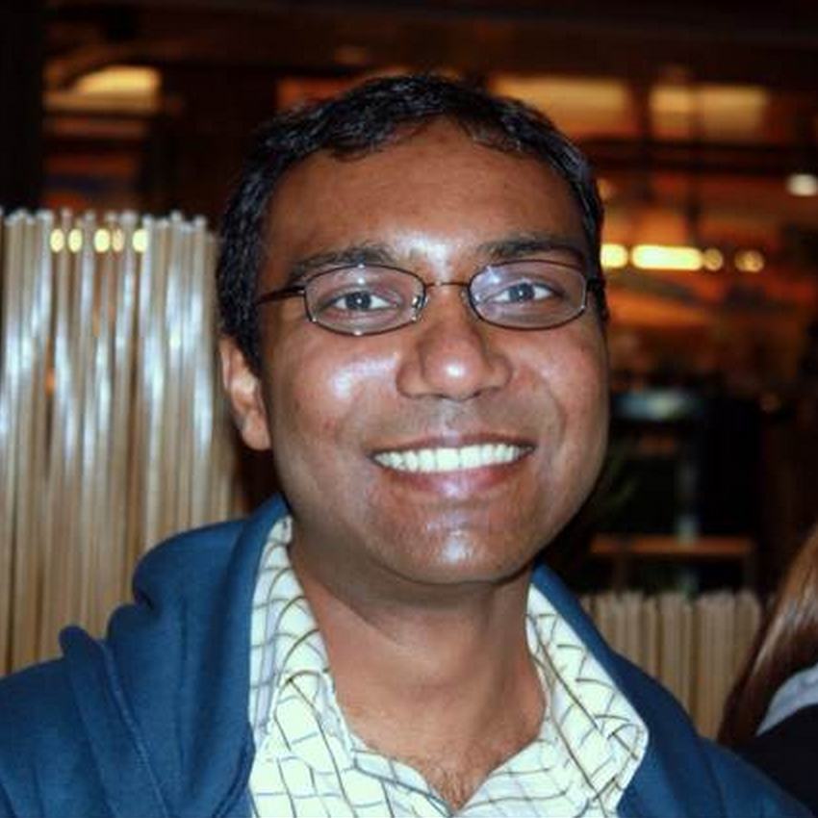

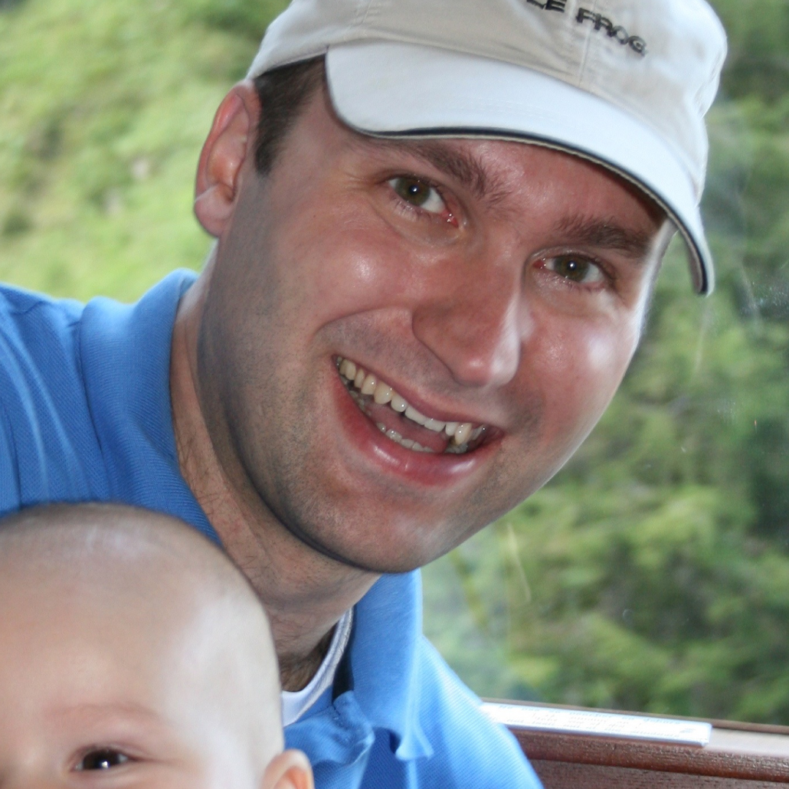


Back in 2014

Slide 15









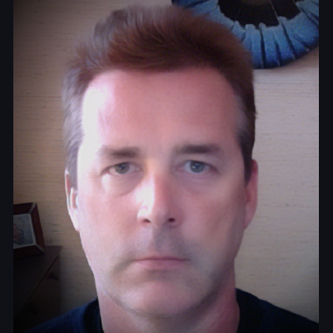
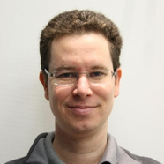


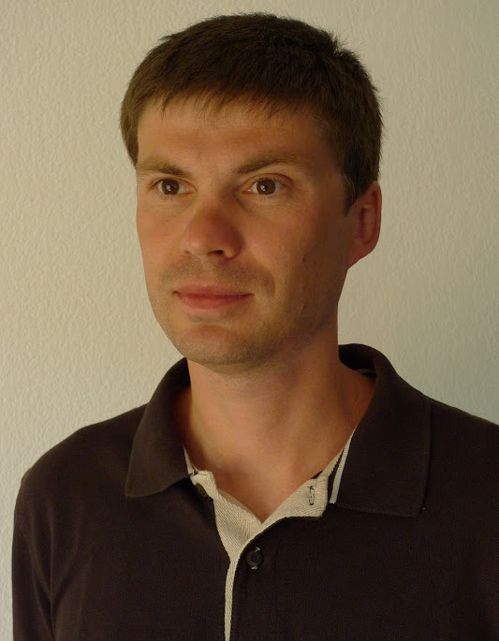
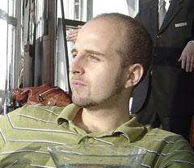



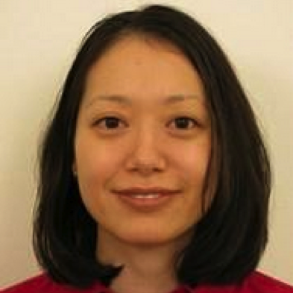

Early 2015
And more!!!

Slide 16

Partners
Notes:
http://en.wikipedia.org/wiki/Amadeus_IT_Group

Slide 17
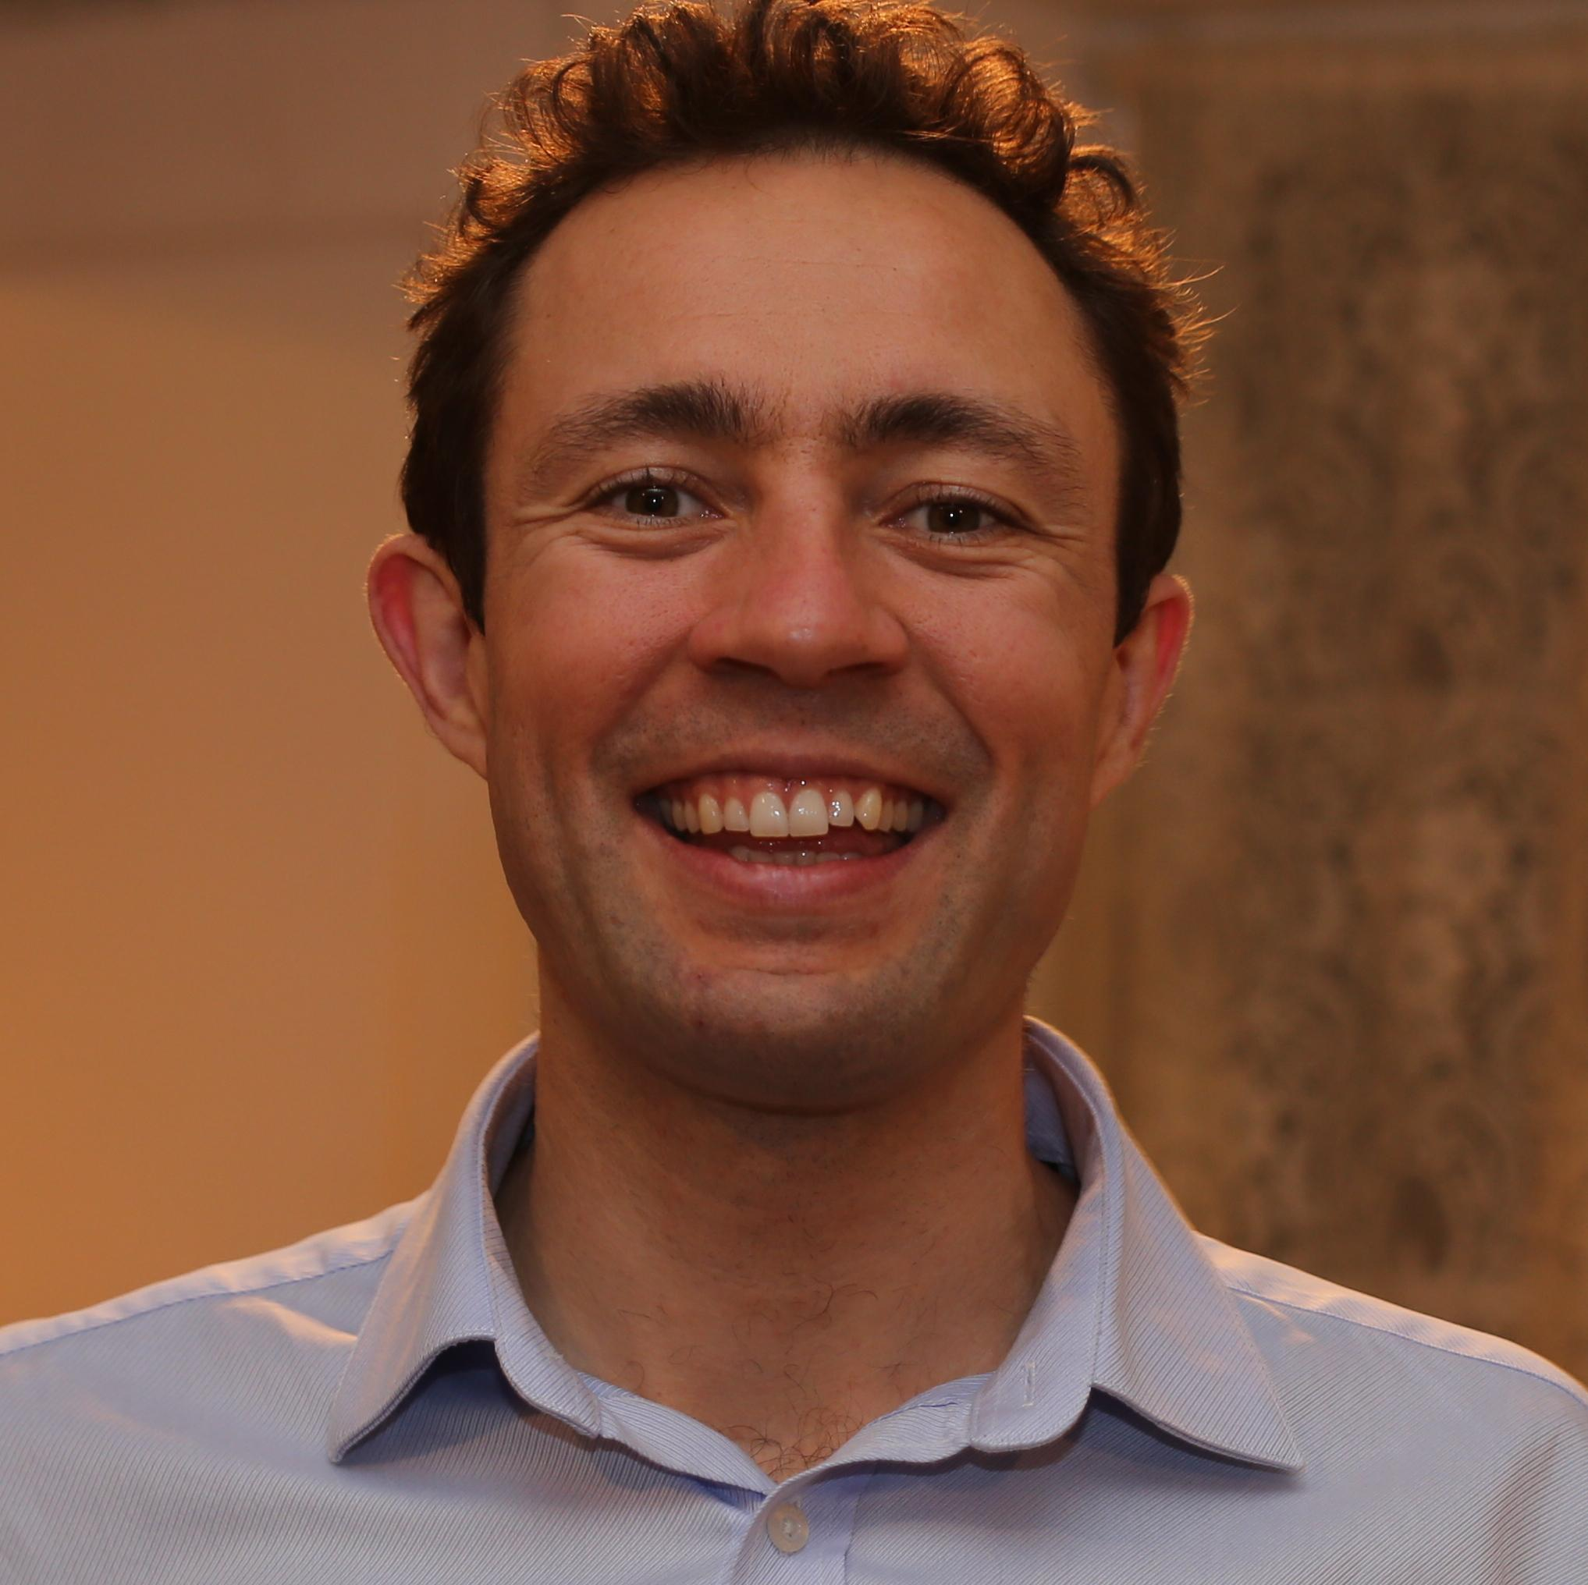
New Angular 1 lead
Pete Bacon Darwin

Slide 18
Angular 1

Slide 19
Your input on v1.4

Slide 20
New Router

Slide 21
New i18n

Slide 22
Better performance

Slide 23
1.4 RC0 next week

Slide 24
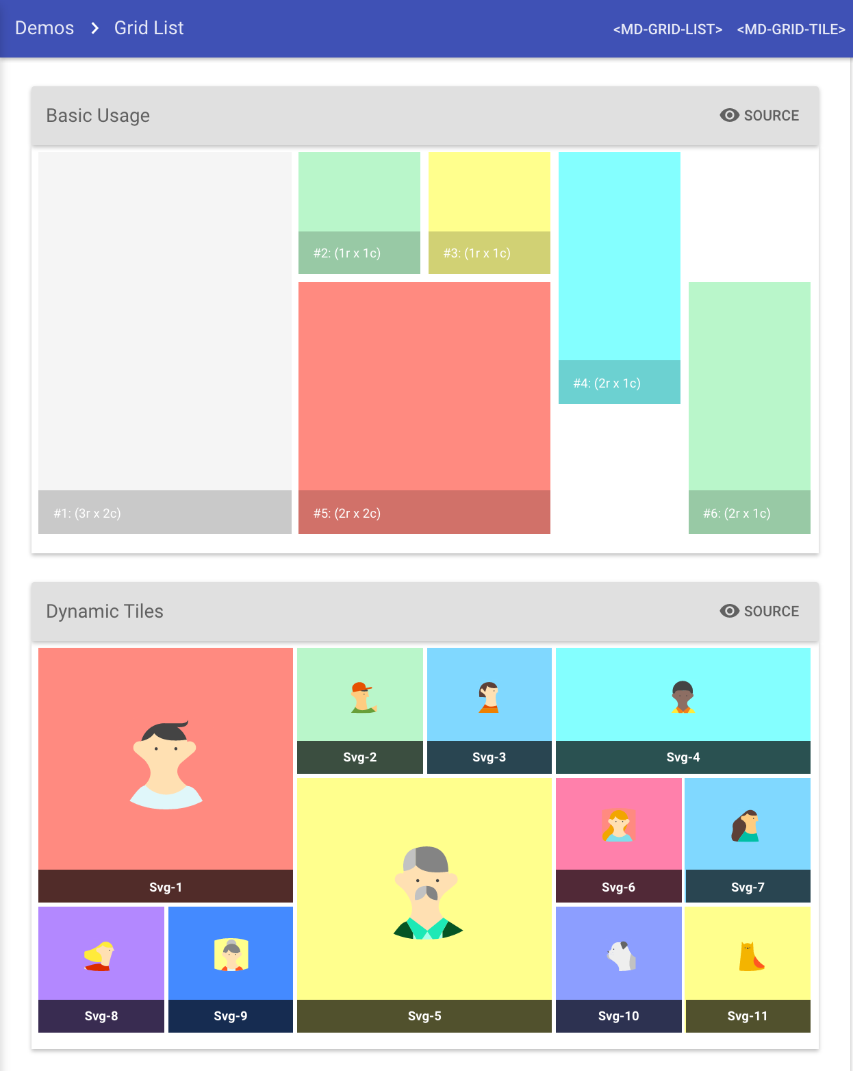
Angular Material

Slide 25
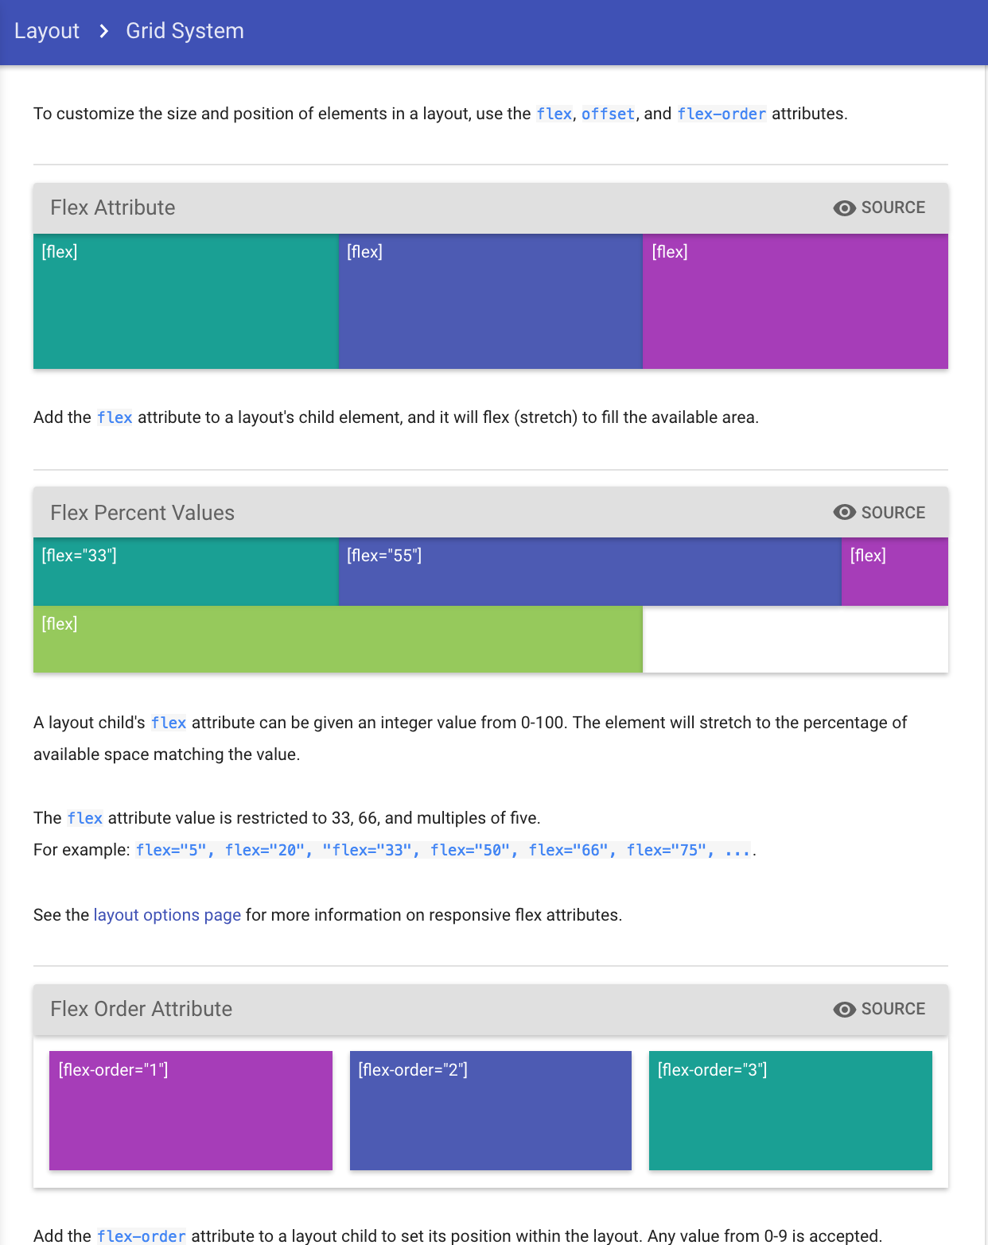
Layout

Slide 26
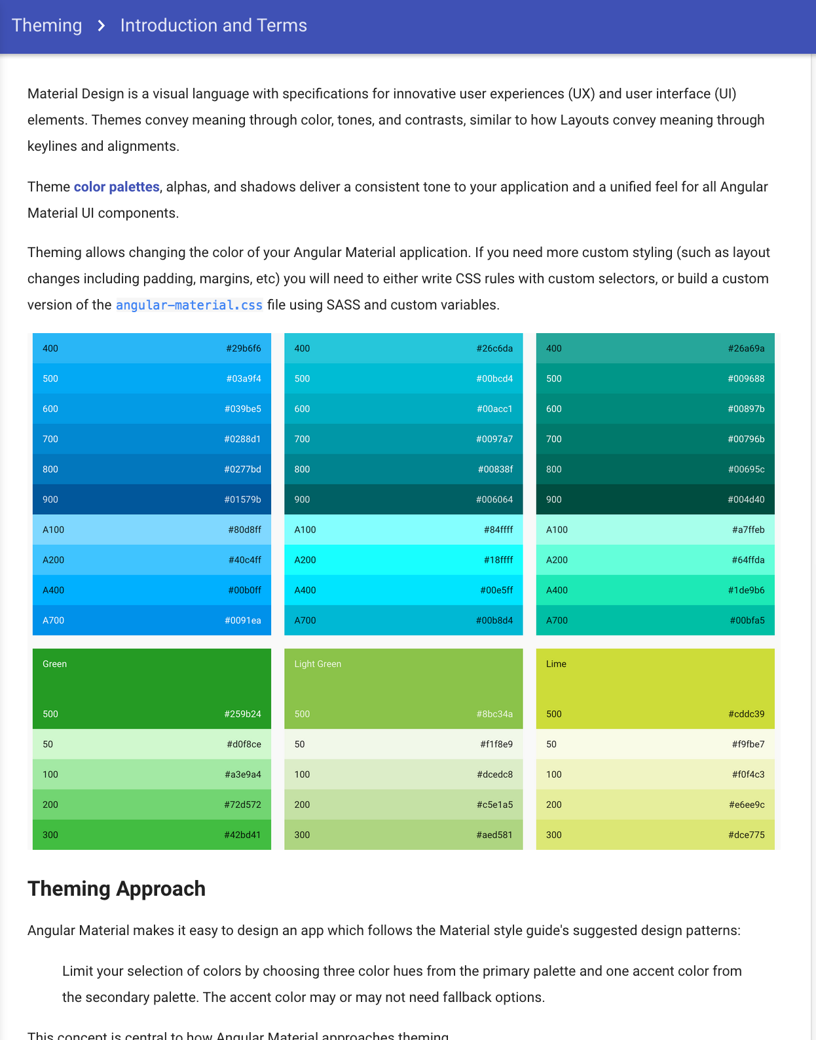
Themes

Slide 28
v1.5, 1.6, ...

Slide 29

Paving the way to Angular 2

Slide 30

Looking forward to your input

Slide 31
Support Plan

Slide 32
Angular @ Google
Number of Apps
3000
?
:-)
2000
2000
1600
1000
0
October 2014
March
2015
2016

Slide 33
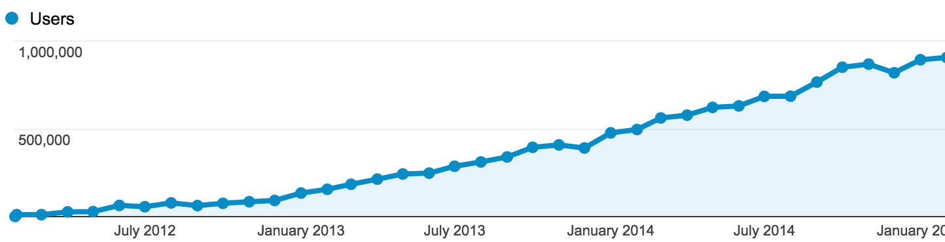
angularjs.org
964K 30-day active users
February 28, 2015

Slide 35

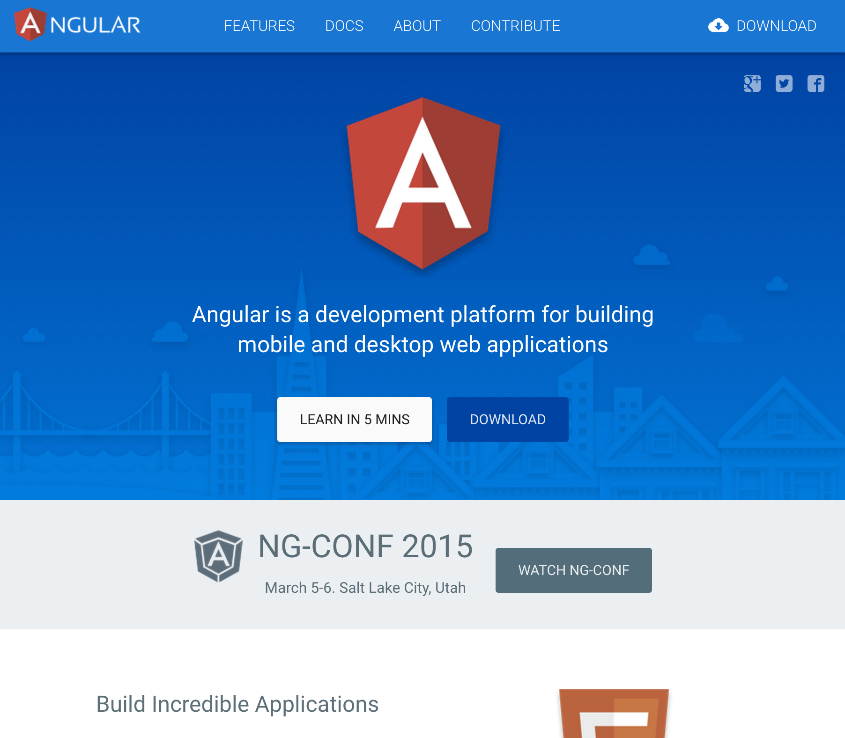
angularjs.org
angular.io

Slide 36
Release Angular 1 until you’re done

Slide 38

Migration

Slide 39


Big Bang
Incremental

Slide 40
A1
A1
A1
A1
Big Bang
A2
A2
A2
A2

Slide 41
Inside-out
A1
A1
A1
A2
Incremental

Slide 42
Outside-in
A2
A1
A1
A1
Incremental

Slide 43
Migration guide
Notes:
mention angular.io as the site where you can find the new quickstart guide and info as we have it. still in preview, full version at our beta later this year.

Slide 44

Style Guide
New Router
ES6 Modules
TypeScript types (optional)

Slide 45
Router
Supported
Angular 1 Themes
i18n
Migration
Material Design

Slide 46
Angular 2
Notes:
mention angular.io as the site where you can find the new quickstart guide and info as we have it. still in preview, full version at our beta later this year.

Slide 47
Simpler
Flexible
Angular 2 Themes
Consistent
Productive
Fast

Slide 48
Angular 2 in alpha
Notes:
mention angular.io as the site where you can find the new quickstart guide and info as we have it. still in preview, full version at our beta later this year.

Slide 49

Angular 1, Angular 2
Similar?

Slide 50

Still in Angular 2
Dependency Injection
Data binding
Directives
Router
Filters
Animation
Accessibility
i18n
Forms
Expressions
Material Design
Protractor
Karma
Mocks

Slide 51
New in Angular 2
Viewports
New languages
Web Components
New template syntax
Unidirectional data flow
Ultra-fast change detection

Slide 52
Productivity

Slide 53
AtScript

Slide 54
AtScript
Annotations
TypeScript
ES6
ES5

Slide 55

Standards
tc39
specification
process

Slide 56

Friends

Slide 57
Jonathan Turner
Program Manager, TypeScript team

Slide 58
Collaboration

Slide 59
AtScript
Annotations
TypeScript
ES6
ES5

Slide 60
Reality
Annotations
TypeScript
ES6
ES5

Slide 61
TypeScript 1.5+
Annotations
Types
ES6
ES5

Slide 63
AtScript
is
TypeScript

Slide 64



Language Options

Slide 65


Why is
good for Angular?

Slide 66
ES5
JS
Angular 2
(JS)
JS Facade
ES6
TypeScript
Traceur
TypeScript
Dart
Angular 2
(Dart)
Dart Facade

Slide 67
Thanks,

Slide 68

Enough for all

Slide 69
Ember, our partner

Slide 71
Simpler

Slide 72
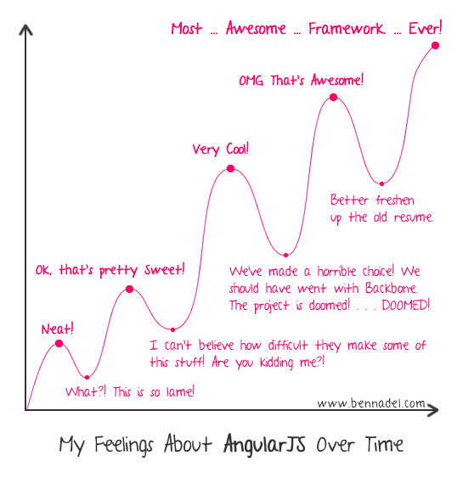

Slide 73

How did we get here?

Slide 74
Generalize
Special Cases

Slide 75
4 template concepts
replace
35 directives

Slide 76
Consistency

Slide 77
Supported by tools

Slide 78
Zones
=
no more $apply

Slide 79
Unidirectional
=
Predictability

Slide 80
ng-model?

Slide 81
Eliminate typos

Slide 82
APIs mirror your needs

Slide 83
Angular
Standards

Slide 84
Performance

Slide 85
Benchmarks

Slide 86
Deep Tree: Speed
February 9, 2015
12
8.58
8
4
3.11
1
1.44
0
Baseline
Angular 2
with
View Cache
Angular 2
Angular 1.3

Slide 87
Deep Tree: Memory Pressure
February 9, 2015
12
9.53
8
4
2.56
1
1.16
0
Baseline
Angular 2
Ultrafast
View Cache
Angular 2
Ultrafast
Angular 1.3

Slide 88
Immutable data structures

Slide 89
Virtual Scrolling Table
February 26, 2015
2000
Angular 1
1500
Time
1000
500
Angular 2
(Ultrafast)
Angular 2
(Immutable Data)
0
2
9
16
23
30
# tables

Slide 90
Virtual Scrolling Table
February 26, 2015
2000
O(n)
1500
Time
1000
500
O(m)
O(1)
0
2
9
16
23
30
# tables

Slide 91
Simpler
Flexible
Angular 2 Themes
Consistent
Productive
Fast

Slide 92
Angular 2 ships when?
First migration
@ Google
Website
preview
Alpha
February
March
May 2015

Slide 93
Why are we here?

Slide 94
#whyruhere #ngconf?

Slide 95
Slides: http://goo.gl/bae2af
Reddit Q&A: http://goo.gl/VqAyaQ

